Slide 1
Artificial Neural Network
Techniques
Dr. Mongkol Ekpanyapong

Slide 2
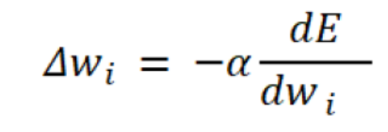
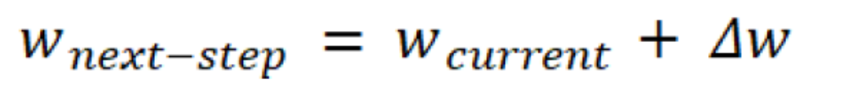
Gradient Descent
Weight function
Weight update

Slide 3

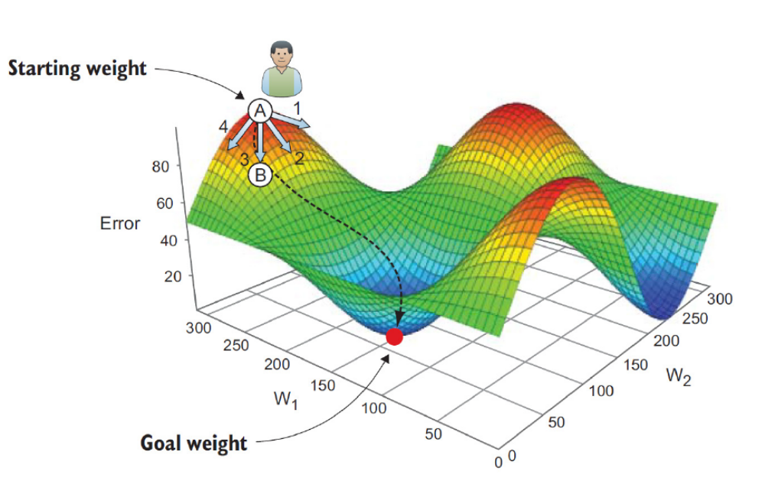
Example

Slide 4
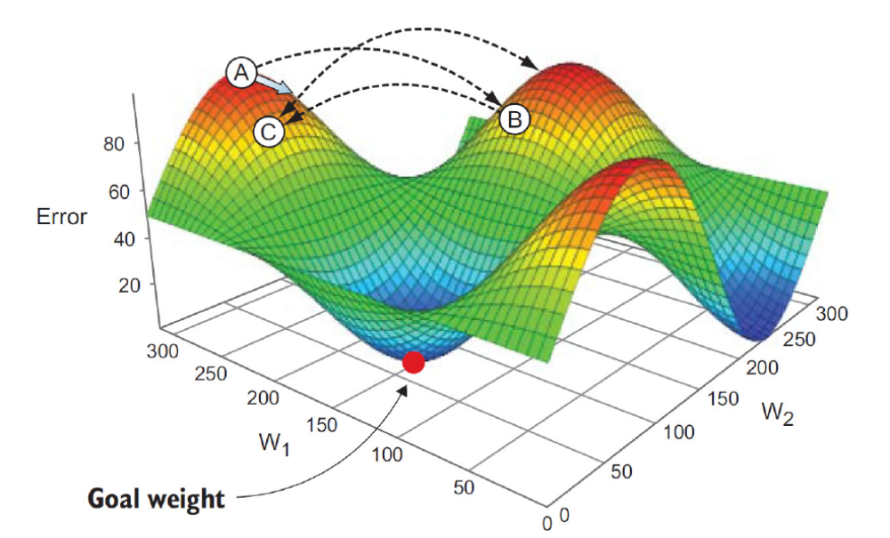
The step size
Impact of large step size

Slide 5
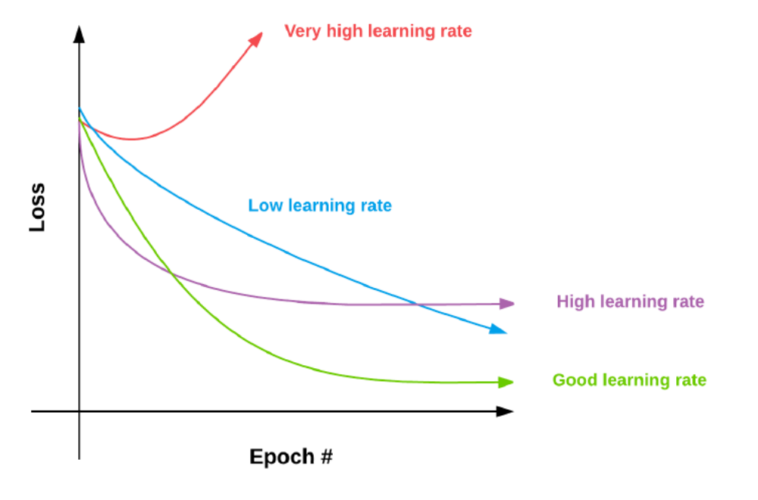
Effects of Learning Rates

Slide 6
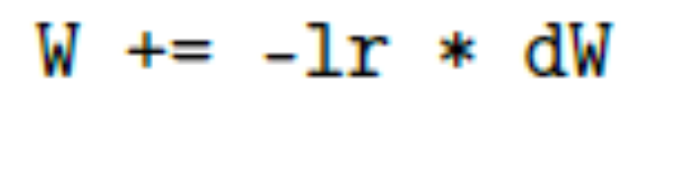
Default SGD weight update
SGD weight update
W is weight matrix
lr is learning rate
dW is the gradient of W

Slide 7
Adaptive Learning Rate?

Slide 8
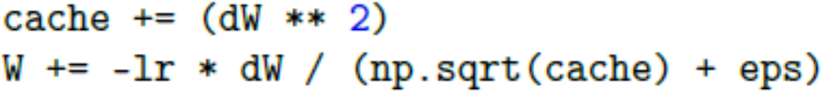
Adagrad
Previously, we performed an update for all parameters using the same learning rate
Adagrad adapts the learning rate to the network parameters. Larger updates are performed on parameters that change infrequently. While small updates are done on parameters changes frequently
Cache is the variable maintains the per-parameter sum of square gradient

Slide 9
RMSprop
Using exponential weighted moving average

Slide 10
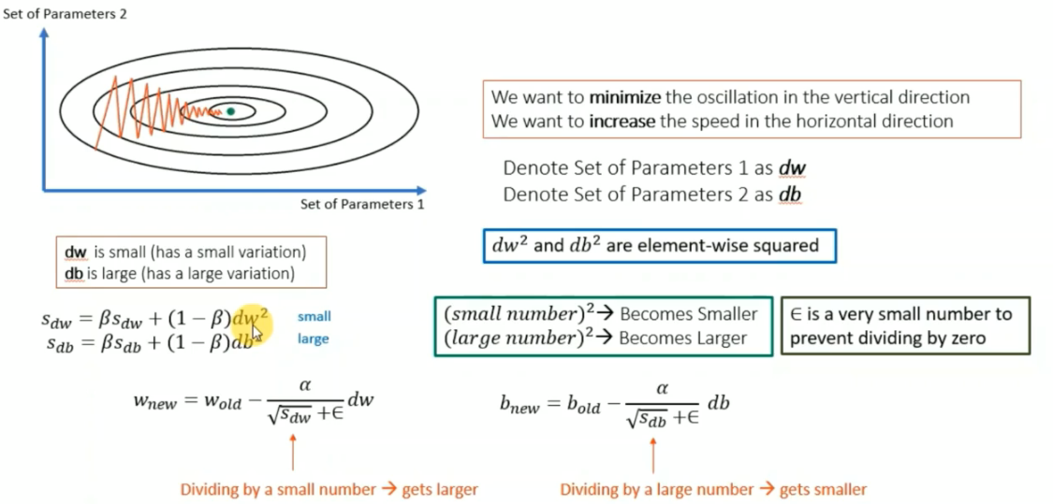
RMSprop
Assume w is parameter 1 and b is parameter 2

Slide 11
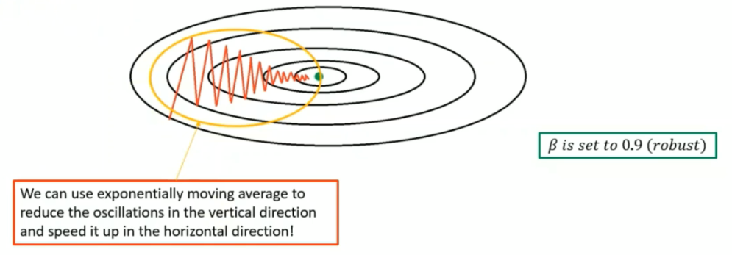
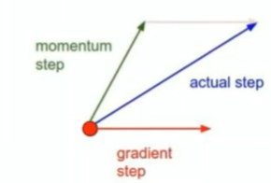
Momentum
F
From W = W - lr * dW
Momentum weight : v = β v + (1- β ) dW
W = W – lr * v

Slide 12
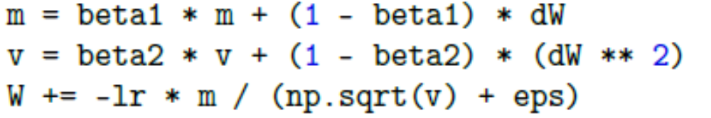
Adam
Adaptive Moment Estimation (Adam) is proposed by Kingman and Ba in 2014
It is similar to RMSprop with momentum added

Slide 13
SGD, Adam, and RMSprop
“The choice of which algorithm to use, at this point, seems to depend largely on the user’s familiarity with the algorithm” –Goodfellow
-Adam and RMSprop provides faster training time
- SGD is well studied

Slide 14
Most used deep learning algorithm
Adam
SGD
RMSprop
Recommendation: try Adam, then SGD with momentum. Then, RMSprop

Slide 15
Training Cifar using Keras
from keras import layers
from keras import models
from keras.datasets import cifar10
from sklearn.preprocessing import LabelBinarizer
model = models.Sequential()
model.add(layers.Conv2D(64, (5, 5), activation='relu', input_shape=(32, 32, 3)))
model.add(layers.MaxPooling2D((2, 2)))
model.add(layers.Conv2D(64, (5, 5), activation='relu'))
model.add(layers.MaxPooling2D((2, 2)))
model.add(layers.Flatten())
model.add(layers.Dense(10, activation='softmax'))
model.summary()

Slide 16
print("[INFO] loading CIFAR-10 data...")
((trainX, trainY), (testX, testY)) = cifar10.load_data()
trainX = trainX.astype("float") / 255.0
testX = testX.astype("float") / 255.0
lb = LabelBinarizer()
trainY = lb.fit_transform(trainY)
testY = lb.transform(testY)
# initialize the label names for the CIFAR-10 dataset
labelNames = ["airplane", "automobile", "bird", "cat", "deer",
"dog", "frog", "horse", "ship", "truck"]
model.compile(optimizer='Adam',
loss='categorical_crossentropy',
metrics=['accuracy'])
H = model.fit(trainX, trainY, validation_data=(testX, testY),
batch_size=250, epochs=100, verbose=1)

Slide 17
Homework:
Please run CIFAR-10 with ADAM, RMSPROP and SGD and compare the performance. Try to get the best performance out of each optimization algorithm

Slide 18
Learning Rate Schedulers
Remember alpha parameter for Gradient Descent algorithm:
If alpha is too high, we can have overshoot case
If alpha is too low, it will take a long time to reach the optimal value
What’s about if the rate can be modified adaptively?

Slide 19
Adaptive Learning Rate Schedule
Finding a set of reasonably “good” weights early in the training process with a higher learning rate
Tuning these weights later in the process to find more optimal weights using a smaller learning rate

Slide 20
Two Approaches for Learning Rate Scheduler
Learning rate schedules that decreases gradually based on the epoch number
Learning rate schedulers that drop based on specific epoch

Slide 21
Keras Implemenation
Keras applies the following learning rate schedule to adjust the learning rate after every batch update

Slide 22
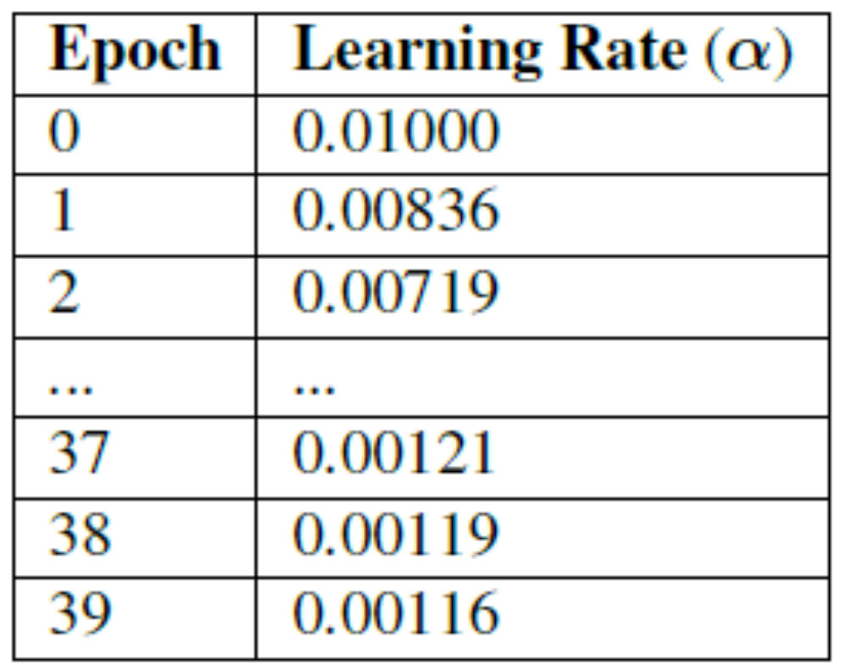
Alpha = 0.01 and decay = 0.01/40

Slide 23
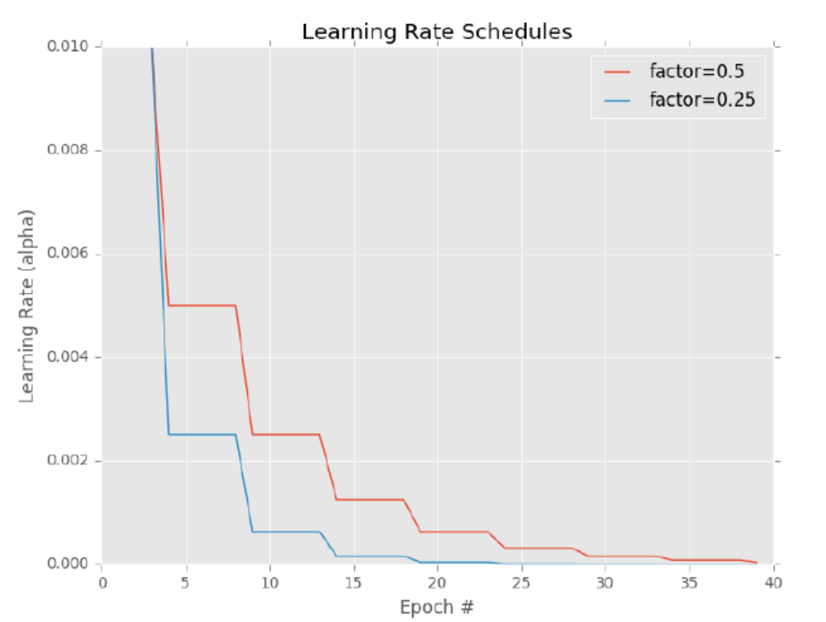
Step-based Decay

Slide 24
Advanced Optimization
Apart from SGD, there are other optimization methods:
Reduce the amount of time (number of epochs) to obtain reasonable classification accuracy
Make the network more “well-behaved” for a larger range of hyperparameters other than the learning rate
Obtain higher accuracy

Slide 25
Spotting Underfitting and Overfitting
What are underfitting?
What are overfitting?
You need to be highly concerned with both underfitting and overfitting

Slide 26
Underfitting
Underfitting occurs when your model cannot obtain sufficiently low loss on the training set

Slide 27
Overfitting
Overfitting occurs when your model predicts the training data so well and fails to generalize to your validation data

Slide 28
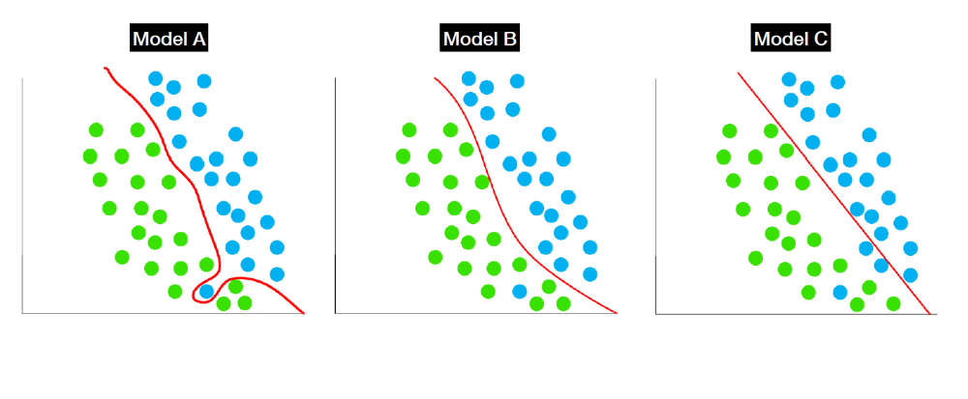
Which model works better?

Slide 29
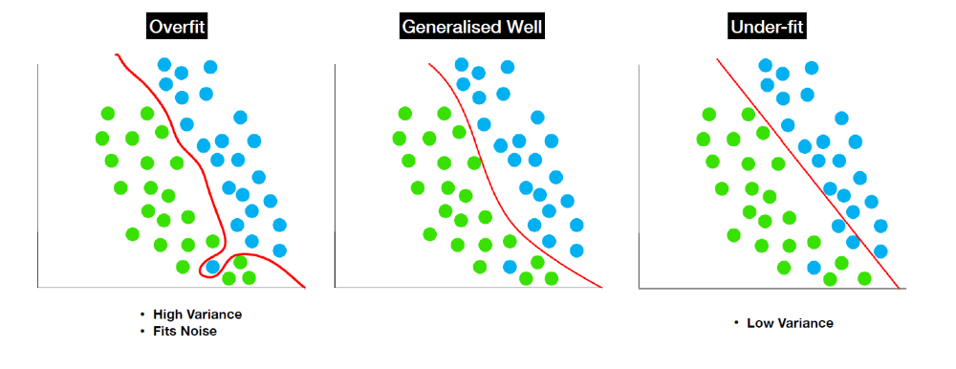
Model B

Slide 30
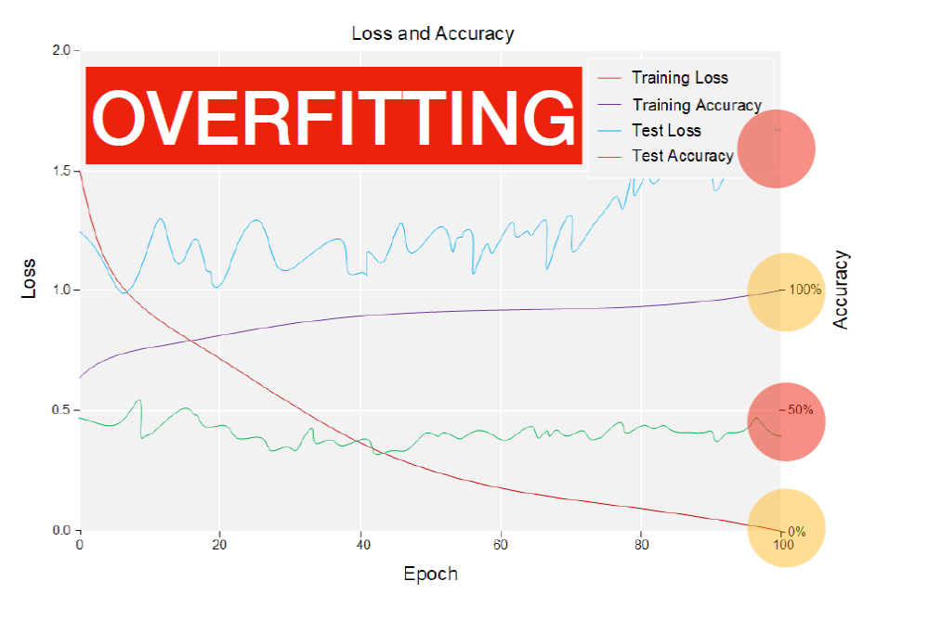
Training accuracy vs. Test accuracy

Slide 31
Regularization
Is a technique to generalize the model
Is a technique used as an attempt to reduce overfitting

Slide 32
Regularization Techniques
L1 & L2 Regularization
Early Stopping
Data Augmentation
Drop Out
Batch Normalization

Slide 33
L1 & L2 Regularization
The idea is to force parameters (weights and biases) to take small values
This helps reduce a node with big weights, but having many nodes with small weights instead

Slide 34
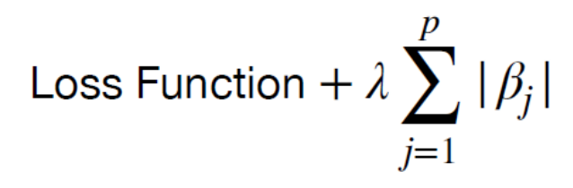
L1 Regularization
β are our weights and λ is a controlled parameter (the value is less than 1)

Slide 35
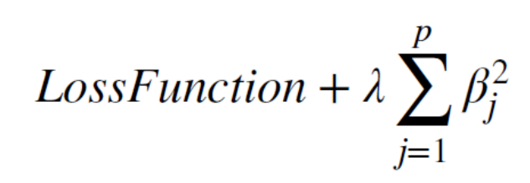
L2 Regularization
β are our weights and λ is a controlled parameter (the value is less than 1)

Slide 36
Differences between L1 and L2
Both try to shrink the weight toward 0
L2 penalizes large weights more
λ is used to control the weight:
  Small means we prefer to minimize the original lost function
  Large means prefers small weights

Slide 37
Early Stopping
At some points during training process, our validation loss may stop decreasing
At this point, we should not continue training
This method is called early stopping

Slide 38
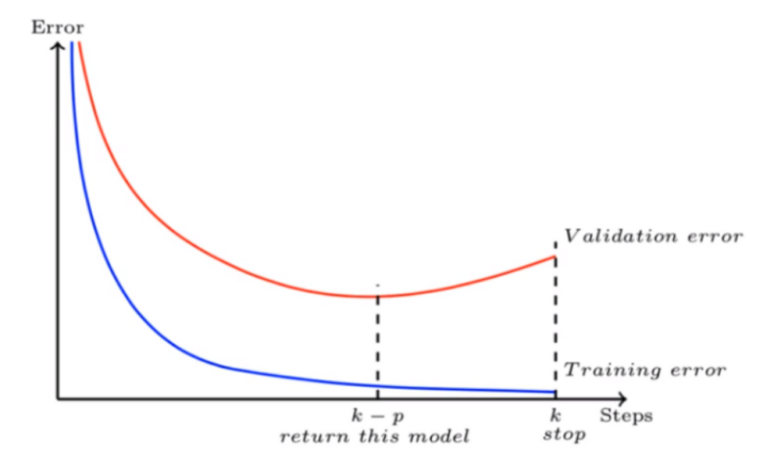
How Early Stopping reduces overfitting
Early stopping ensures that our model does not learn pattern of noise during training

Slide 39
Question?

